Slide 1
Development of master curricula for natural disasters risk management in Western Balkan countries
Planned and realised activities
Milan Gocić
University of Niš
NEO Serbia preventive monitoring/ 20th April 2017
Project number: 573806-EPP-1-2016-1-RS-EPPKA2-CBHE-JP
"This project has been funded with support from the European Commission. This publication reflects the views only of the author, and the Commission cannot be held responsible for any use which may be made of the information contained therein"

Slide 2
Workplan for project year 1
Development of master curricula for natural disasters risk management in Western Balkan countries
Activities |  | Total duration (number of weeks) | M1 | M2 | M3 | M4 | M5 | M6 | M7 | M8 | M9 | M10 | M11 | M12
Ref.nr/ Sub-ref nr | Title
1.1 | Identification of natural disasters to be managed in WB | 18 | 3X= | 3X | 3X | 3X | 3X= | 3X=
1.2 | Introduction with established practices in EU countries for NDRM | 18 | 3X= | 3X | 3X | 3X | 3X= | 3X=
1.3 | Workshop on master curricula best practices in EU countries | 11 |  |  |  |  | 3= | 4= | 4X=
2.1 | Development of aims, specific competencies and learning competencies of master curricula in WB HEIs | 11 |  |  |  |  |  | 2X | 2X | 2X | 2X | 3X
2.2 | Development of courses content and syllabi | 26 |  |  |  |  |  | 3X | 3X | 4X | 4X | 4X | 4X | 4X
2.3 | Training of teaching staff for innovative teaching methods | 9 |  |  |  |  |  |  | = | 2= | 2= | = | = | 2=
2.4 | Providing of students’ internships positions | 1 |  |  |  |  |  |  |  |  | X | X | X | X
2.5 | Harmonization of teaching environment with EU best practices and purchasing of laboratory equipment and literature | 11 |  | 2X | 2X | X | X | X | 2X | 2X
3.1 | Surveillance of citizens’ and public sector awareness regarding natural disasters | 16 |  | 2X | 3X | 3X | 4X | 4X
3.2 | Study visits and analysis of courses best practices in EU countries | 9 |  |  |  |  |  |  | = | 2= | 2= | = | = | 2=
3.3 | Development of trainings’ content corresponding educational materials and selection of teaching staff | 9 |  |  |  |  |  |  |  |  |  | 3X= | 3X | 3X
4.1 | Defining of admission requirements and enrolment of students | 0
4.2 | Implementation of master curricula | 0
4.3 | Implementation of students’ internships | 0
4.4 | Implementation of trainings for citizens and public sector | 0
4.5 | Self-evaluation of master curricula | 0
4.6 | Self-evaluation of trainings for citizens and public sector | 0
5.1 | Regular Quality Assurance Committee meetings | 5 |  |  |  |  |  | 2X= |  |  |  |  |  | 3X=
5.2 | Development of the quality control plan | 6 | 2X= | 2X= | 2X=
5.3 | Conduct external review of the project | 0
5.4 | External financial control | 0
5.5 | Inter-project coaching | 0
6.1 | Creation of the dissemination plan for the project | 6 |  |  | 2X= | 2X= | 2X=
6.2 | Development and maintenance of project website and creation of promotional materials and campaigns | 10 |  | 2X | 2X= | X= | X= | X= | X | X | X | X | X | X
6.3 | Promotional activity for student enrolment | 0
6.4 | Promotional activity for trainings | 2 |  |  |  |  |  |  |  |  |  |  | X | X
7.1 | Creation of sustainability plan | 6 |  | 2X= | 2X= | 2X=
7.2 | Accreditation of master curricula | 0
7.3 | Realization of student and staff mobilities between WB and EU partners | 0
8.1 | Kick-off meeting | 2 | 3X=
8.2 | Regular Steering Committee and Project Management meetings | 5 |  |  |  |  |  | 2X= |  |  |  |  |  | 3X=
8.3 | Development of guidelines on the project management and reporting | 6 |  |  | 2X= | 2X= | 2X=
8.4 | Day-to-day coordination of project activities | 15 | 2X= | 2X= | 2X= | 2X= | 2X= | 2X= | 2X= | 2X= | 2X= | 2X= | 2X= | 2X=
8.5 | Submission of interim and final reports | 0

Slide 3
WP1 – to do list Analysis of natural disasters needed to be managed in Western Balkan region
Development of master curricula for natural disasters risk management in Western Balkan countries
1.1 Identification of natural disasters to be managed in WB
Report on natural disasters in WB – BOKU in consultation with contact persons from all WBC institutions | 14 March 2017 COMPLETED
1.2 Introduction with established practices in EU countries for NDRM
Survey of established practices in EU countries for NDRM – BOKU in consultation with EU partners institutions | 14 March 2017 COMPLETED
1.3 Workshop on master curricula best practices in EU countries
Report on master curricula best practices in EU partners and Catalogue of competencies - BOKU in consultation with contact persons from all institutions (Workshop in Vienna, 4-8 April 2017) | 14 May 2017 Workshop COMPLETED

Slide 4
WP2 – to do list Development of master curricula
Development of master curricula for natural disasters risk management in Western Balkan countries
2.1 Development of aims, specific competencies and learning competencies of master curricula in WB HEIs
Defined aims, specific competencies and learning outcomes of master curriculum per HEI in WB; Catalogue of courses – All WBC institutions | 14 August 2017 In progress
2.2 Development of courses content and syllabi
Defined courses content and syllabi – All WBC institutions | 14 December 2017 In progress
2.3 Training of teaching staff for innovative teaching methods
Teaching staff trained – EU partners in a colaboration with WBC institutions Note: 1) May 2017 - OE (21 staff): UNI - 6, KPA - 3, UPKM - 3, VSUP - 2, TCASU - 2, UNID – 3, UNSA - 2 2) June 2017 - MUHEC (14 staff): UNI - 6, UPKM - 3, UNSA - 3, TCASU – 2 3) July 2017 - TUC (20 staff): UNI - 6, KPA - 3, UPKM - 3, UNSA - 3, VSUP - 2, UNID – 3 4) September 2017 – UNIME (20 staff): UNI - 6, UPKM - 3, UNSA - 3, VSUP - 2, TCASU - 2, UNID – 3, KPA - 1 5) November 2017 - BOKU (12 staff): UNI - 6, KPA - 3, UNSA - 3 | 14 December 2017 Forthcoming

Slide 5
WP2 – to do list Development of master curricula
Development of master curricula for natural disasters risk management in Western Balkan countries
2.4 Providing of students’ internships positions
Agreements for internships signed - All WBC institutions (Only to start collaboration with public sector) | 14 October 2019 Forthcoming
2.5 Harmonization of teaching environment with EU best practices and purchasing of laboratory equipment and literature
Laboratories equipped – All WBC institutions Tendering procedure – UNI (March), TCASU (April), UNSA (April) | 14 June 2017 In progress

Slide 6
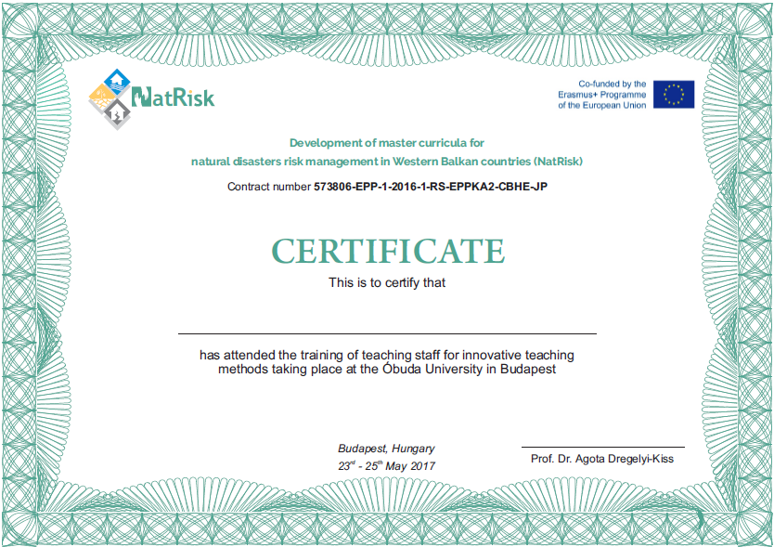
Certificate
Development of master curricula for natural disasters risk management in Western Balkan countries

Slide 7
WP3 – to do list Development of trainings for citizens and public sector
Development of master curricula for natural disasters risk management in Western Balkan countries
3.1 Surveillance of citizens’ and public sector awareness regarding natural disasters
Survey of citizens’ and public sector awareness – UNID in consultation with contact persons from all WBC institutions | 14 April 2017 COMPLETED
3.2 Study visits and analysis of courses best practices in EU countries
Study visit reports – In conjuction with 2.3 | 14 December 2017 Forthcoming
3.3 Development of trainings’ content corresponding educational materials and selection of teaching staff
Trainings’ materials prepared, teachers selected - UNID in consultation with contact persons from all WBC institutions | 14 February 2018 Forthcoming

Slide 8
WP5 – to do list Quality assurance and monitoring
Development of master curricula for natural disasters risk management in Western Balkan countries
5.1 Regular Quality Assurance Committee meetings
Minutes of the meetings – MUHEC in consultation with contact persons from UNI, BOKU, OE (first: BOKU April 2017, second: UNIME September 2017) | 14 October 2019 In progress
5.2 Development of the quality control plan
Quality control plan adopted – MUHEC in consultation with contact persons from UNI, BOKU, OE Work package self-assessment report (March and September) Partner self-assessment report (September) Check list for review deliverables Internal project quality evaluation report (September) | 14 January 2017 COMPLETED

Slide 9
WP6 – to do list Dissemination
Development of master curricula for natural disasters risk management in Western Balkan countries
6.1 Creation of the dissemination plan for the project
Dissemination plan created – UNI in consultation with contact persons from all institutions | 14 March 2017 COMPLETED
6.2 Development and maintenance of project website and creation of promotional materials and campaigns
Promotion material created – All WBC institutions Website and platform launched | 14 October 2019 In progress
6.4 Promotional activity for trainings
Trainings promoted - All WBC institutions | 14 October 2019 Forthcoming

Slide 10
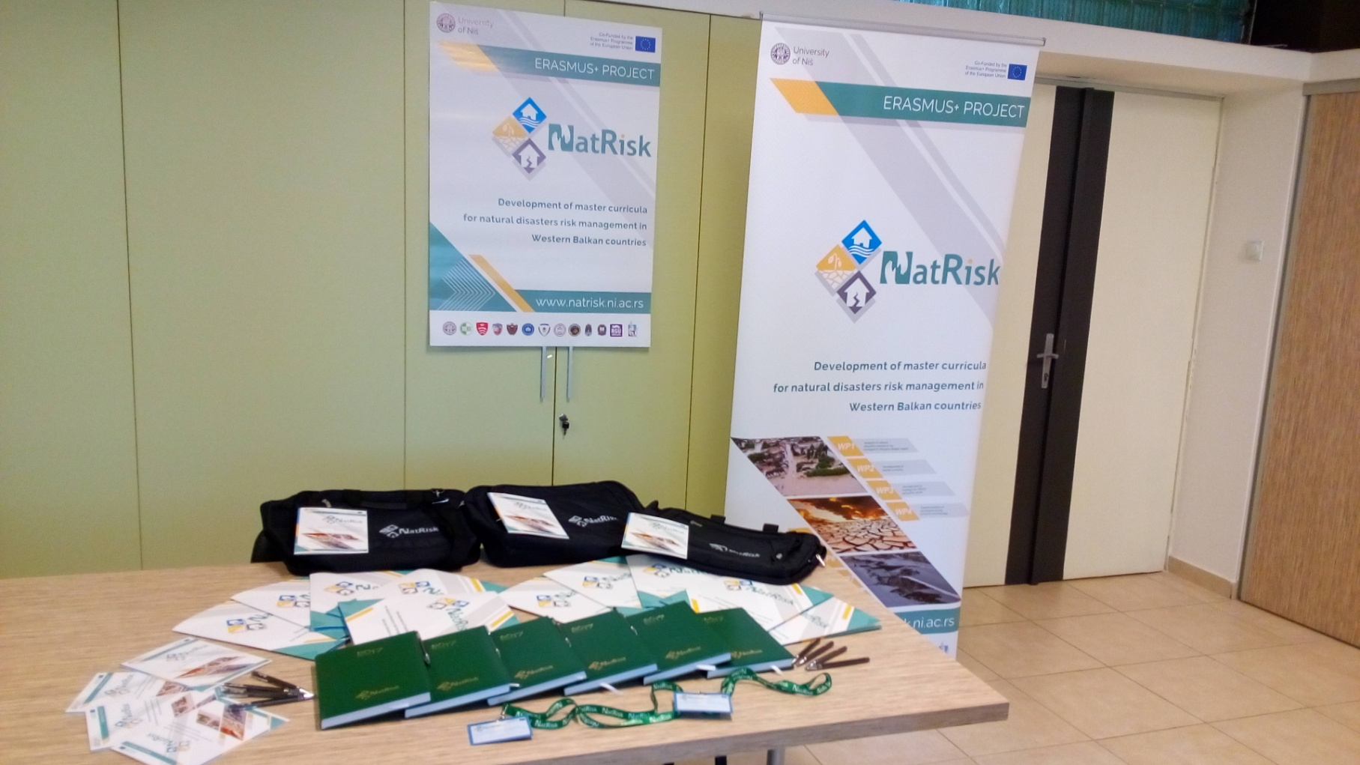
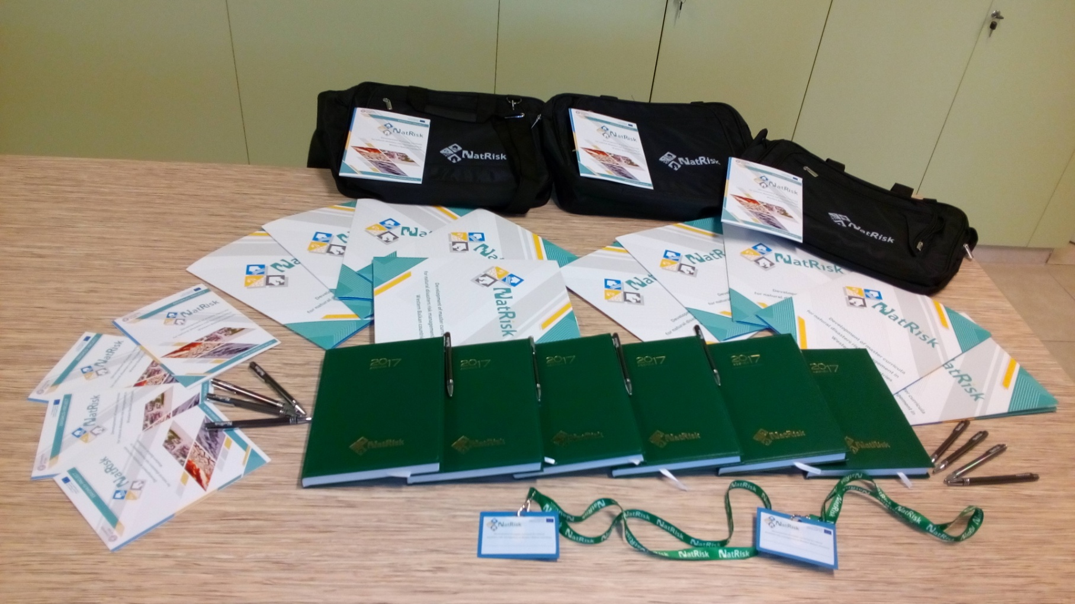
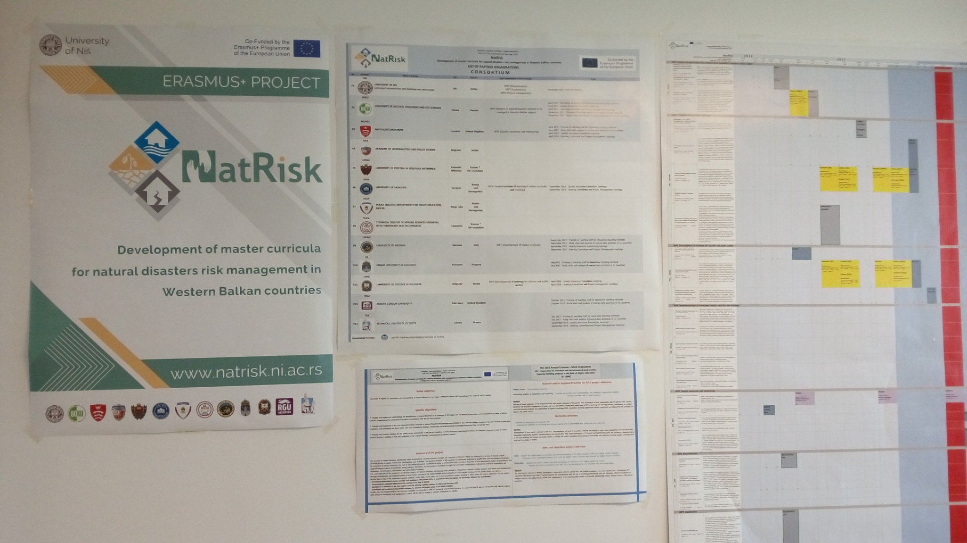
Development of master curricula for natural disasters risk management in Western Balkan countries

Slide 11
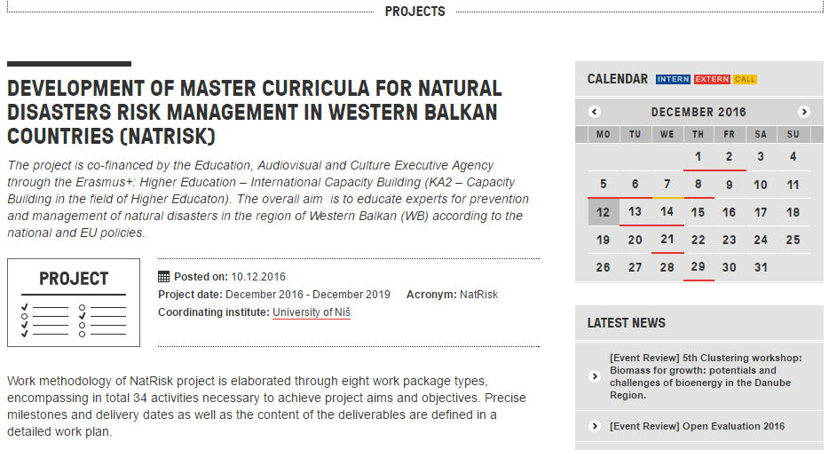
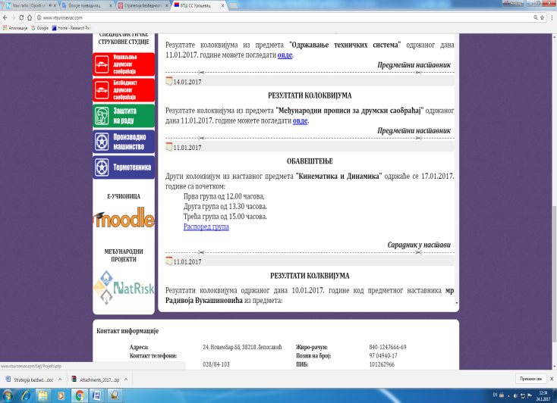
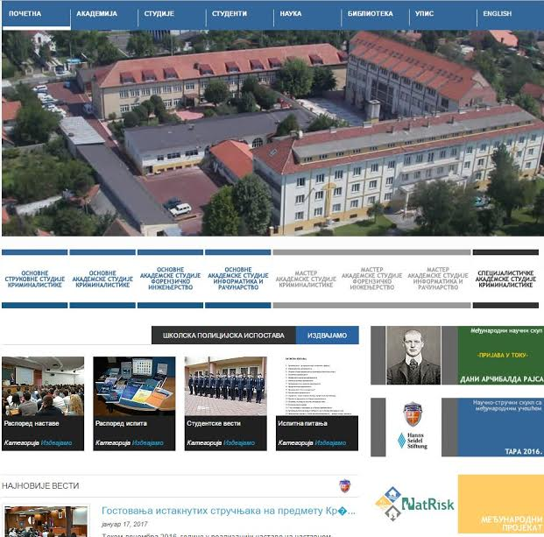
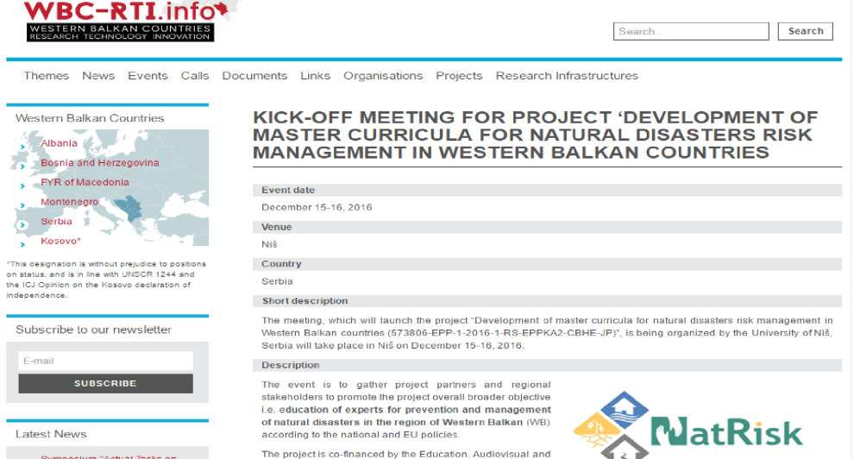
Targeted written material and organisational websites
Development of master curricula for natural disasters risk management in Western Balkan countries

Slide 12
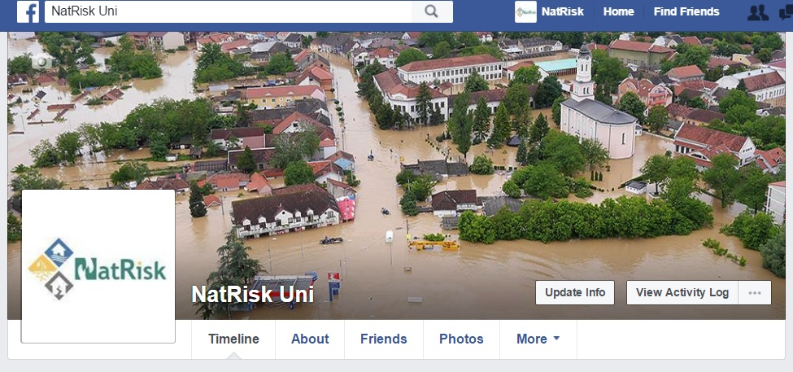
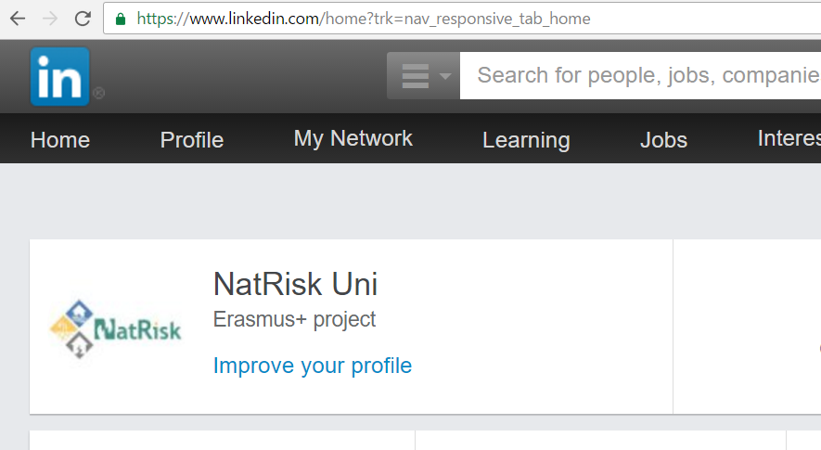
Social networks
Development of master curricula for natural disasters risk management in Western Balkan countries

Slide 13
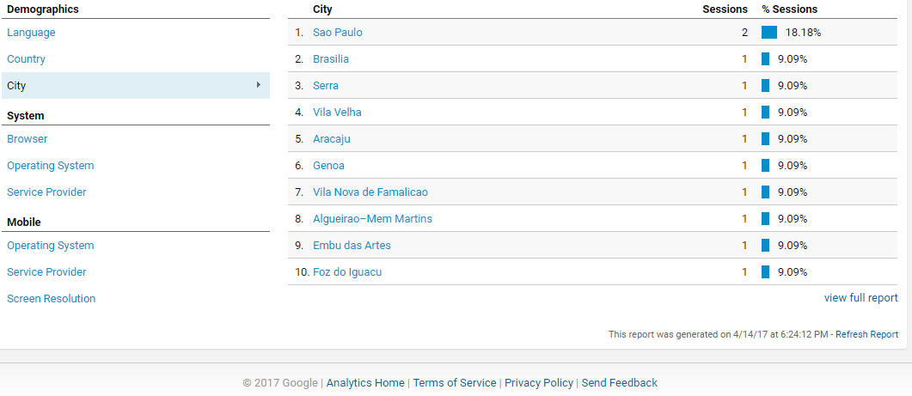
Google analytics
Development of master curricula for natural disasters risk management in Western Balkan countries

Slide 14
WP7 – to do list Exploitation
Development of master curricula for natural disasters risk management in Western Balkan countries
7.1 Creation of sustainability plan
Sustainability plan created - UNI in consultation with contact persons from all institutions | 14 March 2017 COMPLETED

Slide 15
WP8 – to do list Project management
Development of master curricula for natural disasters risk management in Western Balkan countries
8.1 Kick-off meeting
Minutes of the meeting – UNI in consultation with contact persons from all institutions | 14 November 2016 COMPLETED
8.2 Regular Steering Committee and Project Management meetings
Minutes of the meeting – UNI in consultation with contact persons from all institutions (first: BOKU April 2017, second: UNIME September 2017) | 14 October 2019 In progress
8.3 Development of guidelines on the project management and reporting
Guidelines on the project management and reporting created - UNI in consultation with contact persons from all institutions | 14 March 2017 COMPLETED
8.4 Day-to-day coordination of project activities
Project correspondence - UNI in consultation with contact persons from all institutions | 14 October 2019 In progress

Slide 16
Quality assurance
Development of master curricula for natural disasters risk management in Western Balkan countries
Work package self-assessment report (March and September)
Partner self-assessment report (September)
Check list for review deliverables
Internal project quality evaluation report (September)
Self-evaluation report of training
Self-evaluation report of master curiculum
Risk monitoring
Staff mobility report
Student mobility report
Work progress report (each 3 months)

Slide 17
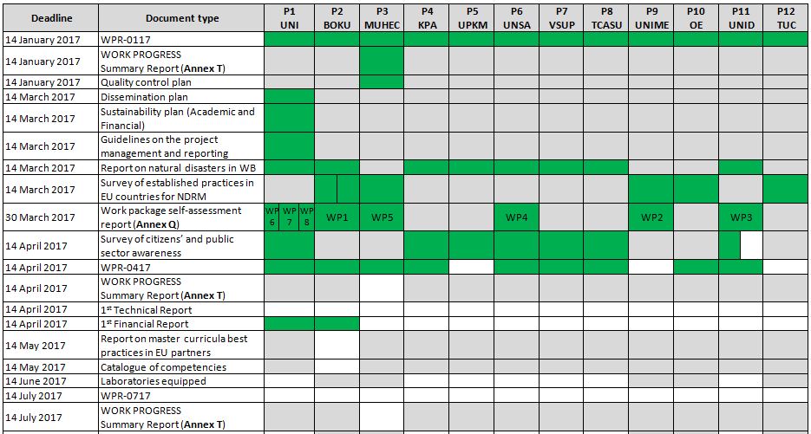
Documentation monitoring - Evidence of documents submission-
Development of master curricula for natural disasters risk management in Western Balkan countries

Slide 18
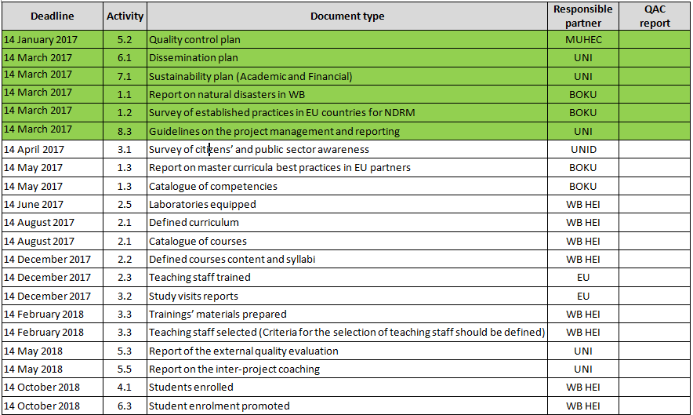
Documentation monitoring - Evidence of deliverables submission-
Development of master curricula for natural disasters risk management in Western Balkan countries

Slide 19
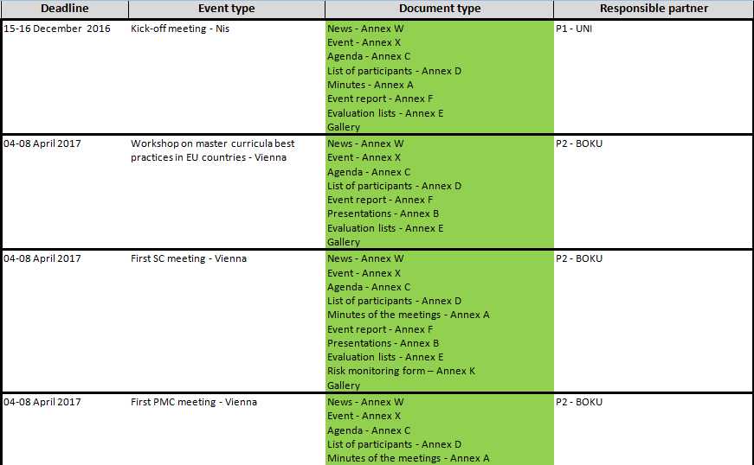
Documentation monitoring - Evidence of trainings, workshop, study visits, meetings-
Development of master curricula for natural disasters risk management in Western Balkan countries

Slide 20
Reports to coordinator
Development of master curricula for natural disasters risk management in Western Balkan countries
Report from the Kick-off meeting
Reports from the meetings of the SC, PMC, QAC to be done by the host institution (2 per year)
Reports from the study visits and workshop to be done by the host institution (6 reports in total)
Reports from staff training sessions (5 reports in total - each one from the EU trainers)
Activity reports - each partner in the project will sent these on every 3 months during the project implementation.

Slide 21
Reports to coordinator
Development of master curricula for natural disasters risk management in Western Balkan countries
Partner’s Financial Report delivered to coordinator | 1st report – April 2017
 | 2nd report – October 2017
Partner’s Technical Report on the implementation of the project delivered to coordinator | 1st report – April 2017
 | 2nd report – October 2017

Slide 22
Administrative and financial issues
Development of master curricula for natural disasters risk management in Western Balkan countries
Grant Agreement – signed (17 November 2016)
Partnership Agreement – signed (December – March) and sent to EACEA (14 March 2017)
Coordinator contact person – changed (08 February 2017)
Robert Gordon University withdrawal – done (23 February 2017)
VAT Certificate that can be used in order to request a tax exemption for the purchase of equipment or services - obtained (03 March 2017)
Amendment to Partnership Agreement - done (03 March 2017)
First instalment of first pre-financing - done (March 2017)
Request for an amendment to the partnership composition by changing one beneficiary by the other (VSUP -> University of Banja Luka) – will be done

Slide 23
Money transfer to partners
Development of master curricula for natural disasters risk management in Western Balkan countries
Code | Partner name | Acronym | Total | 01/2017 | Percentage | Date
P1 | University of Nis | UNI | 364,529.00 | 53,569.00 | 14.70
P2 | University of Natural Resources and Life Sciences, Vienna | BOKU | 66,453.00 | 16,188.25 | 24.36 | 20-Mar-17
P3 | Middlesex University | MUHEC | 59,081.00 | 14,392.75 | 24.36 | 22-Mar-17
P4 | Academy of Criminalistics and Police Studies | KPA | 119,996.00 | 10,906.50 | 9.09 | 08-Mar-17
P5 | University of Pristina in Kosovska Mitrovica | UPKM | 111,248.00 | 9,167.00 | 8.24 | 07-Apr-17
P6 | University of Sarajevo | UNSA | 132,591.00 | 14,906.50 | 11.24 | 20-Mar-17
P7 | Republic of Srpska, Ministry of Interior, Police College, Department for police education, Banja Luka | VSUP | 80,969.00 |  | 0.00
P8 | Technical College of Applied Sciences Urosevac with temporary seat in Leposavic | TCASU | 66,469.00 | 2,852.25 | 4.29 | 08-Mar-17
P9 | University of Messina | UNIME | 65,134.00 | 15,586.00 | 23.93 | 20-Mar-17
P10 | Óbuda University | OE | 34,436.00 | 7,581.50 | 22.02 | 20-Mar-17
P11 | University of Defence in Belgrade | UNID | 104,314.00 | 7,107.25 | 6.81 | 15-Mar-17
P12 | Technical University of Crete, Chania, Greece | TUC | 40,526.00 | 9,056.50 | 22.35 | 20-Mar-17
 |  |  | 1,245,746.00 | 161,313.50 | 12.95

Slide 24
Financial report
Development of master curricula for natural disasters risk management in Western Balkan countries
Code | Partner name | Acronym | Total | 01/2017 | 18-Apr-17 | Percentage
P1 | University of Nis | UNI | 364,529.00 | 53,569.00 | 31,004.32 | 57.88
P2 | University of Natural Resources and Life Sciences, Vienna | BOKU | 66,453.00 | 16,188.25 | 13,852.00 | 85.57
P3 | Middlesex University | MUHEC | 59,081.00 | 14,392.75 |  | 0.00
P4 | Academy of Criminalistics and Police Studies | KPA | 119,996.00 | 10,906.50 |  | 0.00
P5 | University of Pristina in Kosovska Mitrovica | UPKM | 111,248.00 | 9,167.00 |  | 0.00
P6 | University of Sarajevo | UNSA | 132,591.00 | 14,906.50 |  | 0.00
P7 | Republic of Srpska, Ministry of Interior, Police College, Department for police education, Banja Luka | VSUP | 80,969.00 | 0.00 |  | 0.00
P8 | Technical College of Applied Sciences Urosevac with temporary seat in Leposavic | TCASU | 66,469.00 | 2,852.25 |  | 0.00
P9 | University of Messina | UNIME | 65,134.00 | 15,586.00 |  | 0.00
P10 | Óbuda University | OE | 34,436.00 | 7,581.50 |  | 0.00
P11 | University of Defence in Belgrade | UNID | 104,314.00 | 7,107.25 |  | 0.00
P12 | Technical University of Crete, Chania, Greece | TUC | 40,526.00 | 9,056.50 |  | 0.00
 | Total in percentage: 3.6% |  | 1,245,746.00 | 161,313.50 | 44,856.32 | 27.81

Slide 25
Project issues
Development of master curricula for natural disasters risk management in Western Balkan countries
Visual identity: project logo, promotiaonal material, project web site, project platform – created (December 2016)
Kick-off meeting - organised (14-16 December 2016)
Minutes on the kick-off meeting and evaluation report – written (December 2016)
12 Work Progress Reports – written (February 2017)
Work Progress Summary Report – written (February 2017)
Quality control plan – written (February 2017)
Dissemination plan – written (March 2017)
Sustainability plan (academic and financial) – written (March 2017)

Slide 26
Project issues
Development of master curricula for natural disasters risk management in Western Balkan countries
Guidelines on the project management and reporting – written (March 2017)
Report on master curricula best practices in EU partners – written (March 2017)
Report on natural disasters in WB countries - written (March 2017)
Tendering procedure – started (March and April 2017)
2400 questionnaires in WB countries – collected (March 2017)
Workpackage self-assessment reports - written (March 2017)
Workshop in Vienna – organised (April 2017)
First SC, PMC and QAC meetings – organised (April 2017)

Slide 27
Further project issues
Development of master curricula for natural disasters risk management in Western Balkan countries
Survey of established practices in EU countries for NDRM written – April 2017
Catalogue of competencies written – April 2017
Survey of citizens’ and public sector awareness written – April 2017
Workshop organised and related reports written – April 2017
Work Progress Reports written – April 2017
Work Progress Summary Report written – April 2017
First Financial Report written – April 2017
First Technical Report written – April 2017
Tendering procedure finished and laboratories equpped – June/July 2017

Slide 28
Further project issues
Development of master curricula for natural disasters risk management in Western Balkan countries
Work Progress Reports written – July 2017
Work Progress Summary Report written – July 2017
Defined aims, specific competencies and learning outcomes of master curriculum per HEI in WB written – August 2017
Catalogue of courses written – August 2017
Second meeting of SC, QAC, PMC organised and reports written - September 2017
5 study visits and trainings organised and related reports written – November 2017
Several promotional and informative events organised and/or participated in
Project promoted through media

